Slide 1
Data Science Class 5
Puranjit Singh
09/15/2021

Slide 2

Introduction to objects
Python is an object-oriented programming language
Everything is in Python treated as an object, including –
Variable
Function
List
Tuple
Dictionary
Set, etc.
Every object belongs to its class.
An object contains the following properties.
State
Behavior
Identity
Notes:
Object-oriented programming is based on the concept of objects. In object-oriented programming data structures, or objects are defined, each with its own properties or attributes. Each object can also contain its own procedures or methods.
State - The attributes of an object represents its state. It also reflects the properties of an object.
Behavior - The method of an object represents its behavior.
Identity - Each object must be uniquely identified and allow interacting with the other objects.

Slide 3
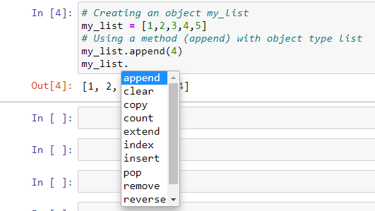
Methods in Python
Methods -
In Python, a method is a function that is available for a given object because of the object's type
Methods are essentially functions built into objects and are already created
Format for calling a method is: (object_name.method_name)
Fortunately, with the jupyter notebook we can quickly see all the possible methods using the tab key

Slide 4
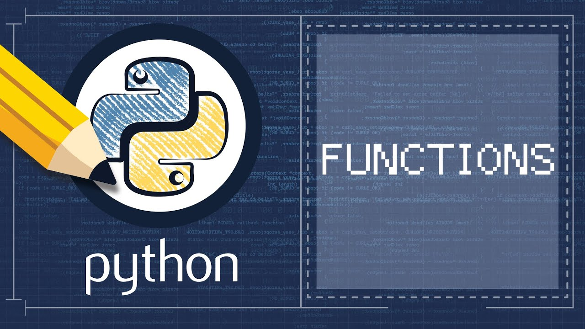
What are functions in Python?
A function is a group of related statements that perform a specific task
Functions can be used when we plan on using a block of code multiple times.
The function will allow you to call the same block of code without having to write it multiple times.
There are two types of functions –
User-defined functions
Built-in functions
https://www.analyticsvidhya.com/blog/2021/07/all-fundamentals-of-python-functions-that-you-should-know-a-quick-brush-up/
Notes:
With the help of Functions, we can break our program into smaller and modular chunks. So, when our program grows larger and larger, functions help us to make it more organized and manageable.
User defined - These functions are defined by the user to perform a specific task.
Built-in - These functions are pre-defined functions in Python.

Slide 5
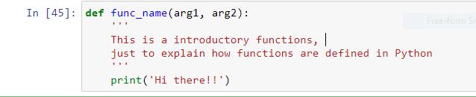
Defining a function
There are a few rules to define a function in Python –
Function blocks begin with the keyword def followed by a function name and parenthesis
The code block within every function starts with a colon (:) and is indented
The statement return [expression] exits a function, optionally passing back an expression to the caller. A return statement with no arguments is the same as return None
A list of examples are included in Jupyter notebook to better understand functions

Slide 6
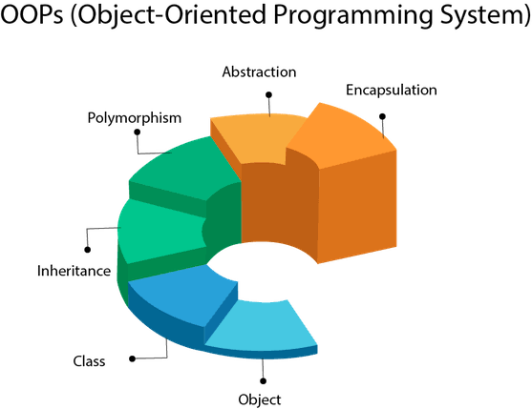
Object-oriented programming
In Python, object-oriented Programming (OOPs) is a programming paradigm that uses objects and classes in programming.
It aims to implement real-world entities like-
Objects
Class
Inheritance
Polymorphisms
Abstraction
Encapsulation etc. in the programming.
https://medium.datadriveninvestor.com/learn-object-oriented-programming-oop-in-minutes-18d9f957b387

Slide 7
Basic properties of OOPs
Inheritance - inheritance allows us to define a class that inherits all the methods and properties from another class
Encapsulation - this puts restrictions on accessing variables and methods directly and can prevent the accidental modification of data.
Abstraction - is a concept of object-oriented programming, where user is only able to see the basic functionalities and internal details are hidden
Polymorphism - polymorphism lets us define methods in the child class that have the same name as the methods in the parent class

